Slide 1
System Analysis and Project Management – Requirements Determination and Use Case Modeling
Prepared By - Vesh Raj Joshi

Slide 2
Determining Requirements
What are requirements?
Requirements define what a system should do and the constraints under which it should operate. What a system should do falls under the category of Functional Requirements, while the constraints are described by Non-Functional Requirements.
What is requirement determination?
Requirements determination is the process of studying the existing system and gathering details to find out what are the requirements, how it works, and where improvements should be made.
Requirements are best determined by system analyst and business people together.
The hardest single part of building a software system is deciding precisely what to build. – Frederick Brooks

Slide 3
Strategies for Analyzing Requirements
Busines Process Automation(BPA)
Least amount of changes to the current system
Use computer technology to automate some protions
Problem analysis
Ask users to identify problems with the current system
Ask users how they would solve these problems
Good for improving efficiency or ease of use
Root cause analysis
Focus is on the cause of a problem, not its solution
Create a prioritized list of problems
Try to determine their causes
Once the causes are know, solution can be developed

Slide 4
Strategies for Analyzing Requirements
Business Process Improvement(BPI)
Moderate amount fo change is required
Design to improve efficiency of the current system
Duration analysis
Determine the time required to complete each step in a business process
Compare this to the total time required for the entire process.
Large differences suggest problems that might be solved by:
Integrating some steps together
Performing some steps simultaneously
Activity based costing – same as duration analysis but applied to the costs.
Informal benchmarking – analyzes similar processes in other successful organizations

Slide 5
Strategies for Analyzing Requirements
Business Process Reengineering(BPR)
Most amount fo change – a complete makeover
Focus is on the to-be system - little time spent on the current system
Institutes maximum changes: “Out with old and in with the new”
Techniques:
Outcoume analysis – What does the customer want in the end?
Technology analysis - apply new technologies to business processes and identify benefits
Activity Elimination – eliminate each activity in a busines process in ”force fit” exercise

Slide 6
Stages of Requirement Gathering Process
Identify the right stakeholders
Define the Project: Understand the project goals and scopes
Elicit the requirements from the stakeholders
Document the requirements
Confirm the requirements with the client and stakeholders to ensure transparency
Prioritize the needs based on discussion with the clients

Slide 7
Stages of Requirement Gathering Process
1. Identify the right stakeholders Identify the key people who will be affected by the project. Start by clarifying exactly who the project's sponsor is. This may be an internal or external client. Either way, it is essential that you know who has the final say on what will be included in the project's scope, and what won’t. Then, identify who will use the solution, product, or service. These are your end-users. Your project is intended to meet their needs, so you must consider their inputs.

Slide 8
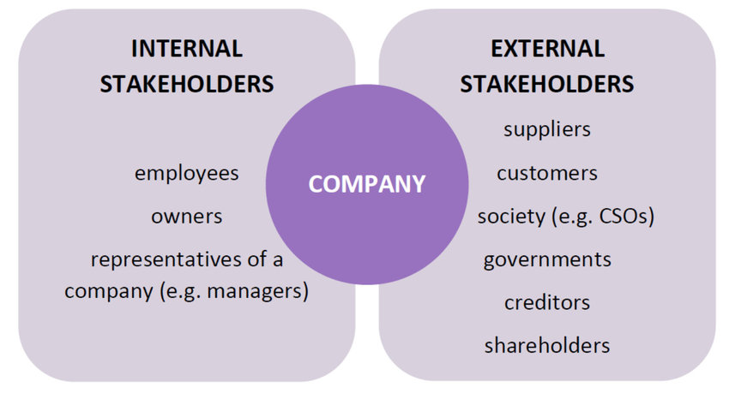
Stages of Requirement Gathering Process
1. Identify the right stakeholders

Slide 9
Stages of Requirement Gathering Process
1. Identify the right stakeholders – RACI Tools
RACI stands for Responsible, Accountable, Consulted, and Informed.
It's basically a chart that shows the different responsibilities people hold on your project.
You and the stakeholders should create the matrix together to ensure that it's accurate and that everyone is on the same page.
﻿﻿Each letter corresponds to a level of responsibility:
﻿﻿Responsible: The actual person performing the work.
﻿﻿Accountable: The one ultimately answerable for the correct completion of the deliverable or task.
Consulted: Those whose opinions are sought, typically subject matter experts.
Informed: Those who are kept up-to-date on progress.

Slide 10
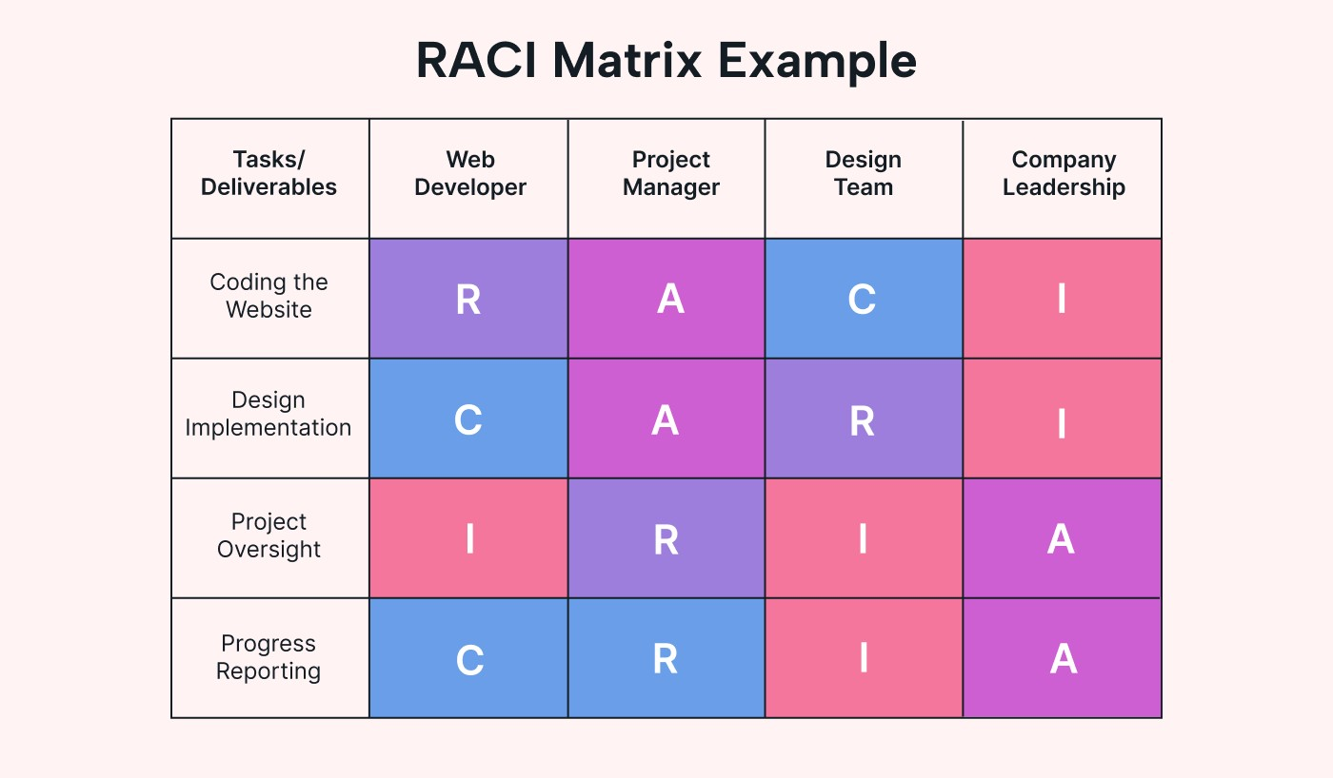
Stages of Requirement Gathering Process
1. Identify the right stakeholders – RACI Tool

Slide 11
Stages of Requirement Gathering Process
2. Project Definition Project definition is the stage where we define the project's objectives and try to understand the goal and the scope of the project so that once we jot down all the necessary requirements based on the interaction with the stakeholder and the client, we can start the process of project initiation.
Things that take place in project definition stage:
﻿﻿﻿Defining the project scope and goals
﻿﻿﻿Clearing all the assumptions, assessing the risks, and identifying the dependencies of the project
﻿﻿﻿Identifying the business stakeholders to elicit all the requirements based on interaction
﻿﻿﻿By performing a Cost-benefit analysis, we can identify if the benefits of the project outweigh the underlying costs.
﻿﻿﻿Defining how the business analyst will handle changes in the requirements and what would be the process for approval in case of changes.
﻿﻿﻿The budget required and available budget for the project.
﻿﻿﻿Identifying the success criteria of the project

Slide 12
Stages of Requirement Gathering Process
3. Requirement elicitation Requirement elicitation is a process of gathering the correct information from the internal and external stakeholders. Requirement elicitation can be performed in several ways:
﻿﻿Surveys
﻿﻿Questionnaires
﻿﻿Interviews
﻿﻿One-on-one meetings
﻿﻿User stories
﻿﻿Brainstorming sessions
Process Diagramming
﻿﻿Follow-Up Meetings
﻿﻿Workshops etc
Note: This step helps ensure taking information from the right people and taking notes, enabling you to prepare the documents based on the requirements gathered during these elicitation techniques.

Slide 13
Stages of Requirement Gathering Process
4. Requirement Documentation
In this stage, we document the requirements that we have gathered. Proper documentation is required to understand the stakeholder/client's needs and ensure the same is communicated to the development team who is involved in project deliverables.
﻿﻿The documents include product requirement documents, system requirement documents, business requirement documents, etc.
﻿﻿Ensure to prepare the document in such a way that the development team can easily interpret the requirements and prioritize the work based on the requirements specified.

Slide 14
Stages of Requirement Gathering Process
4. Requirment documentation - Categorize Requirements To make analysis easier, consider grouping the requirements into these four categories-
Functional Requirements – These define how a product/service/solution should function from the end-user’s perspective. Thety describe the features and functions with which the end-user will interact directly.
Operational Requirements – These define operations that must be carried out in the background to keep the product or process functioning over a period of time
Technical Requirements – These define the technial issues that must be considered to successfully implement the process or create the product.
Transitional Requirements - These are the steps needed to implement the new product or process smoothly.

Slide 15
Stages of Requirement Gathering Process
4. Intercept and Record Requirements- Categorize Requirements Once you have gathered and categorized all of the requirements, determine which requirements are achievable, and how the system or product can deliver them. To intercept the requirements, do the following –
Define requirments preciesly
Not ambigous or vague
Clearly worded
Sufficiently detailed os that everything is known.(Project ober runs and problems usually come from unknowns ahta were not identified or sufficiently well-analyzed.)
Related to the business needs
Listed in sufficient detail to create a working system or product design.

Slide 16
Stages of Requirement Gathering Process
4. Intercept and Record Requirements- Categorize Requirements
Analyze the impact of change - Carry out an Impact Analysis to make sure that you understand fully the consequences your project will have for existing processes, products and people.
﻿﻿Resolve conflicting issues - Sit down with the key stakeholders and resolve any conflicting requirements issues. You may find Scenario Analysis helpful in doing this, as it will allow all those involved to explore how the proposed project would work in different possible "futures".
Analyze feasibility - Determine how reliable and easy to use the new product or system will be. A detailed analysis can help identify any major problems.

Slide 17
Stages of Requirement Gathering Process
5. Confirmation of the requirements
Once the requirements are adequately documented, take approvals from the clients and stakeholders so that you can start the project.
﻿﻿Without taking approvals from the client, you may delay the project.
﻿﻿Furthermore, as requirements might change with time and without proper permissions, scope creep, project delays, or even cancellation will occur.

Slide 18
Stages of Requirement Gathering Process
6. Prioritizing the requirements
Prioritizing requirements involves determining which requirements are most important to the project's success and need to be developed and implemented first. The following are some of the prioritization techniques used in business analysis:
﻿﻿MoSCoW: MoSCoW stands for Must have, Should have, Could have, and Won't have. This technique prioritizes requirements based on their importance and urgency.
﻿﻿Kano Model: The Kano Model prioritizes requirements based on the customer's satisfaction level. It categorizes requirements into three categories: Must-haves, Performance Attributes, and Delighters.
﻿﻿Cost-Benefit Analysis: Cost-benefit analysis evaluates the costs and benefits of each requirement to prioritize them based on their feasibility and impact on the project's success.
﻿﻿Business Value Analysis: Business value analysis prioritizes requirements based on their impact on the organization's goals and objectives.

Slide 19
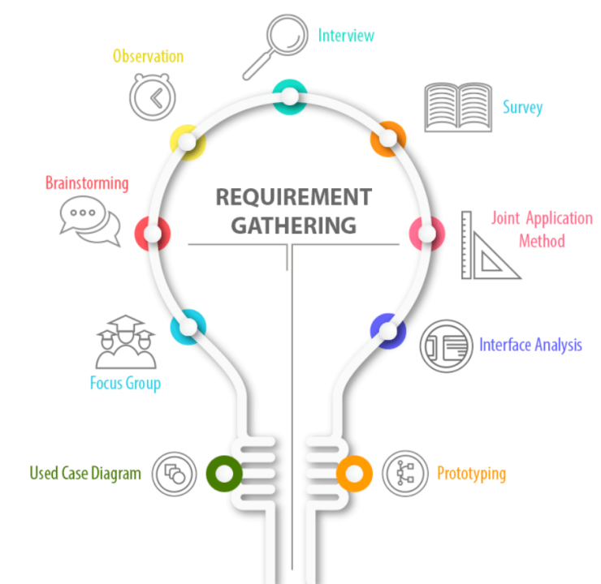
Requirement Gathering Techniques
Focus Group
Brainstroming
Interviews
Joint Application Method
Shadowing/Observation
Document Analysis
Surveys/Questionnaire
Interface Analysis
Prototyping/Wireframing

Slide 20
Requirement Gathering Techniques
Focus Group
Semi structured “group interview” and focused discussion with moderator
Stakeholders are subjet expert and selection of participant is most crucial
Group is homogeneous and socially oriented
6-12 participants and discussion could be upto 3 hours.
Explore attitude, opinions, behaviours, beliefs & recommendations of a group.
Define problems, gather reactions to proposed solutions, explore feelings and reasons behind differences.
Difficult to recruit, questionable reliability if hiring go wrong.

Slide 21
Requirement Gathering Techniques
Brainstroming
This technique is primarily used during the project discovery phase, wherein the project’s requirements are not clearly identified.
In this session, make sure that you include the stakeholders who are aware of the system and also identify the project needs, benefits and costs incurred.

Slide 22
Requirement Gathering Techniques
Interviews – if you need to know something, just ask
Select people to interview and create schedule
Design interview questions(open-ended, closed-ended, and probing types of questions).
Prepare for the interview(Unstructured Vs Structured interview organized in a logical order)
Conduct the interview
Follow up after interview – prepare notes and sends to the interviewee for verification

Slide 23
Requirement Gathering Techniques
Interviews – Interview Question types
Closed Ended Questions- Questions that limit the possible answers to a short or specific response or a choice from a limited set. Or can be answer in yes no or specific number.
Open Ended Questions- Questions can not be answered with a simple yes/no, and instead require the respondent to elaborate on their perspective.
Probe questions: typically open-ended, meaning there is more than just one response. Most probing questions begin with 'what,' 'why' or 'how.

Slide 24
Requirement Gathering Techniques
Workshop or Joint Application Development(JAD)
JAD is a methodology that involves bringing together stakeholders, developers and end users in collaborative workshops to design and develop computer applications that solve real world problems.
Typically workshop organized in neutral locations
Workshop for 10-20 users at a time
Identify the underlying issues and stakeholders responsible for resolving them.

Slide 25
Requirement Gathering Techniques
Shadowing/Observation
Shadowing the client for a couple of days seems helpful in understanding the office environment, current system design, and processes in place, recording the user behavior and understanding the underlying needs based on the problems in the current process.
Users/Managers often don’t remember everything they do
Behavours may change when people are watched
Workers tend to be very careful when watched
Keep a low profile
Try not to interrupt or influence workers
Be careful not to ignore periodic activities – weekly, monthly and anually

Slide 26
Requirement Gathering Techniques
Document Analysis
In this technique, a business analyst collects the existing documents for a deeper analysis. The benefits of using document analysis are :
Helps identify key stakeholders
Helps prepare the right set of questions for follow up meetings and workshops
It helps understand the existing process in place
It helps find the missing information and redundant processes that could be fixed
It helps in understanding the unclear requirements that might be stated by stakeholders.
Review typical user documents: Forms, reports, policy manuals
Review technical docuemnts if available;
Look for unused elements

Slide 27
Requirement Gathering Techniques
Surveys/Questionnaire
Surveys seem like a viable option to send out to various people and record their responses based on the project requirement:
Valuable when time is limited and the focus group is enormous.
Stakeholders donot reside in the same location and may be in different time zones, so scheduling an interview or workshop with entire group may be seemingly challenging to execute
It helps avoiding repeating the same questions and investing extra time to gather input on feedback and feature enhancement.
Steps to questionnaire
Select participants
Designing the questionnaire – remove ambiguities
Administering the questionnaire – get good response rate; offer incentives
Questionnnaire follow-up; send results to participants; send a thank you

Slide 28
Requirement Gathering Techniques
Prototypeing and wireframing
Visual techniques used in the process of designing and building software, apps and website
Wireframing is basic sketch of blueprint that shows how the system or website will look and function, while a prototype is a more detailed and interactive model of the system that explains how it will behave and function
The purpose of these techniques is to help both the business team and the end users visualize and understand the requirements and expectations of the system, identify potential issues or areas for improvement, and ensure that the final product is user friendly, effective, and efficient.
Eliminate any confusions or assumptions
Easier to capture and identify missing requirements; actively stakeholders suggestions increases efficiency
Allows users to see how the model will work once the project is executed

Slide 29
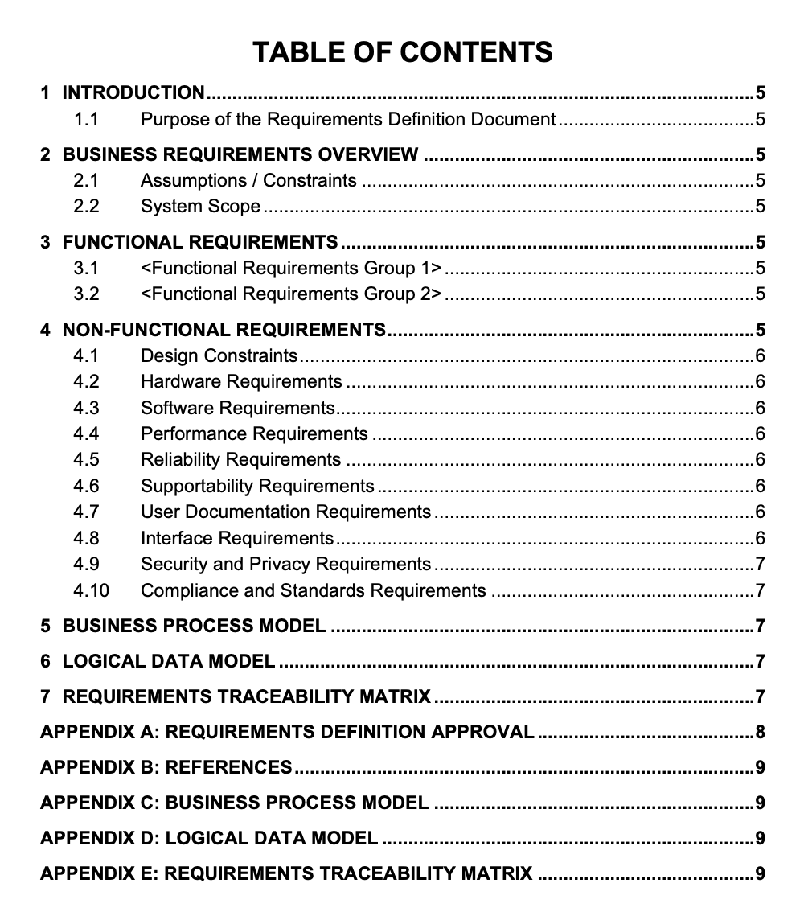
Developing the Requirements definition statement
A requirements definition statement is a document that defines the functional, technical, and operational, non-functional requirements of a project. Its created during the requirements analysis phase of a project.

Slide 30
Use Case Analysis
Use Case
Is a specific situation in which a product or service could potentially be used and describes the behavior of a system to do a particular task.
is dialogue between an actor and the system.
A use case is a pattern of behavoir, the system exhibits.
The use cases are sequence of actions that the user takes on the system to get particular target.
Roles of Use Cases
A use case is a set of activities that produce some output result.
Describes how the system reacts to an event that triggers the system
Trigger – event that visualises the use case to be executed
Event driven modeling – Everything in the systemis a response to some triggering event.

Slide 31
Use Case Analysis
Use Case Diagram A use case diagram is a graphical depiction of a user’s possible interactions with a system. A use case diagram shows various use cases and different types of users of the system has and will often be accompained by other types of diagrams
Use case diagram objective
Representing the goal of system user interactions
Defining and organizing functional requirements in a system
Specifying the context and requirements of a system
Modeling the basic flow of events is a use case.

Slide 32
Use Case Analysis – Use Case Diagram
Use Case Diagram Components
Use Case – A use case represnets a user goal that can be achieved by accessing the system or software application
Actor – Actors are used to represent the users of system, actors can actually be anything that needs to exchange information with the system
Use Case

Slide 33
Use Case Analysis – Use Case Diagram
Use Case Diagram Components
System or System Boundary– Scope of a system can be represented by a system(shape), or sometimes known as a system boundary. The use cases of the system are placed inside the system shape, while the actor who interact with the system are kept out side of the system.
Include – An include relationship specifies how the behavior for the inclusion use case is inserted into the behavior defined for the base use case.
<<include>>

Slide 34
Use Case Analysis – Use Case Diagram
Use Case Diagram Components
Extends – An extend relationship specifies how the behavior of the extension use case be inserted into the behavior defined for the base use case.
Generalization – A generalization relationship is used to represent inheritance relationship between model elements fo same type.
<<extend>>

Slide 35
Use Case Analysis – Use Case Diagram
Actor
An actor is some one or something that must interact with the system under development
Actors can be human or automated systems
Actors are not part of the system
UML notation for actor is stickman
Actors carry out use cases and single actor may perform more than one use cases
Actors are determined by observing the direct uses of the system
Primary Actor
Acts on the system
Initiate an interaction with the system
Uses the system to fulfill his/her goal
Events something we don’t have control over
Secondary Actor
Is actoed on/invoked/used by the system
Helps the system to fulfill its goal
Something the system uses to get its job done

Slide 36
Use Case Analysis – Use Case Diagram
Generalization
Generalization is a relationship between general use case and a more specific use case that inherits and extends features to it.
Use cases that are specialized version of ther uses cases
It is shown as a solid line with hollow arrow point
The actor order registry clerk can instantiate the general use case Place order
Place order can also be specialixed by the use cases Phone order or internet Order
Place order
Order Registry clerk
Internet Order
Phone Order
Customer
Internet Customer

Slide 37
Use Case Analysis – Use Case Diagram
<<include>>
Include –
The base case explicitly incorporates the behavior of another use case at a location specified in the base
The included use case never stands alone. It only occurs as a part of some larger base that includes it.
Extends
The base use case implicitly incorporates the behavior of another use case at certain points called extension points.
The base use case may standalone, but under certain conditions its behavior may be extended by the behavior of another use case
Base
Included
Base
<<extend>>
Extend

Slide 38
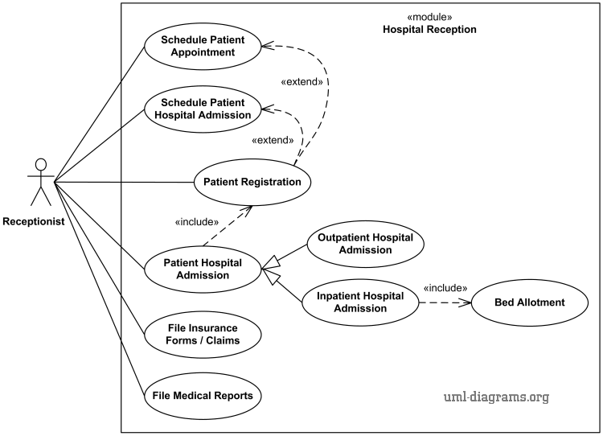
Use Case Analysis – Use Case Diagram
Include/extends Example

Slide 39
Use Case Analysis – Use Case Diagram
How to create use case diagram
List main system functions(use cases) in a column:
think of business events demanding system’s response
Users’ goals/needs to be accomplished via the system
Create, Read, Update, Delete (CRUD) data tasks
Naming cases- user’s need usually can be translated in data tasks
Draw ovals around the function labels
Draw system boundary
Draw actors and connect them with use cases(if more intiutive, this can be done as step 2)
Specify include and extend relationships between uses cases (yes, at the end - not before, as this may pull you into process thinking, which does not apply in UC diagramming).

Slide 40
Use Case Analysis – Use Case Diagram
Use case Diagram : Question 1
A use case placing an order with sales company follow these steps
Browse catelog and select items
Call sales representative
Supply shipping information
Supply payment information
Receive conformation number from sales person
Translate use case sequesnce in to use case diagram

Slide 41
Use Case Analysis – Use Case Diagram
Use case Diagram : Question 1
The sales person could also be included in this use case diagram because the sales person is also interacting with the ordering system
Browse Catlog and select items
Call Sales persion
Customer
Give Shipping Info
Give Payment Info
Get confirmation

Slide 42
Use Case Analysis – Use Case Diagram
Use case Diagram : Question 2
The site user and the webmaster are the actors. The site user wants to search for documents, browse documents, and view events. These are the use cases or the functionality the user wants to do. The download and preview documents are the use cases too, and they are in relation to each other based on user requirements.
The webmaster upload documents, post new events to the homepage and add a user and these use cases are in relation with the managed folders and add company but still based on what the actor wants
Translate use case sequesnce in to diagram

Slide 43
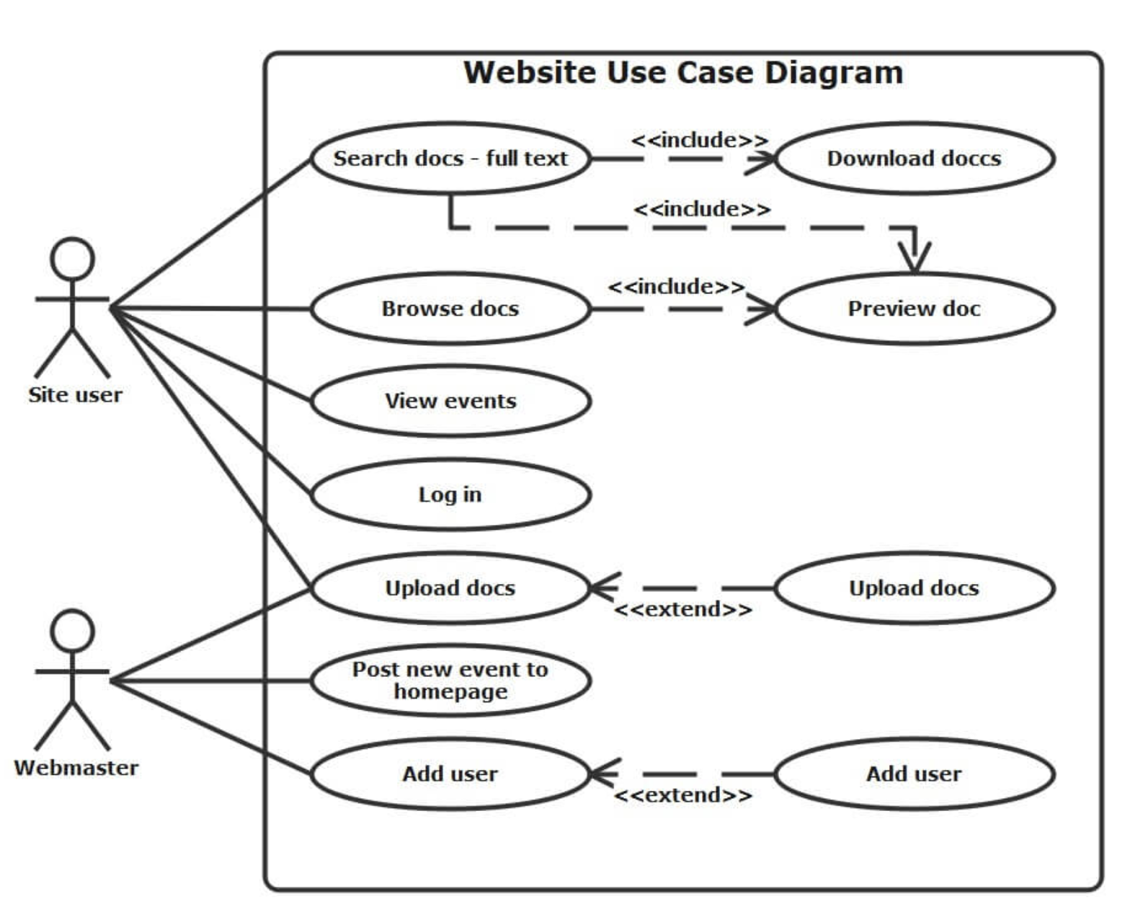
Use Case Analysis – Use Case Diagram
Use case Diagram : Question 1

Slide 44
Use Case Analysis – Tool as capturing functional requirements
Use Case for Functional Requirements
Use cases do explain the user’s interaction with the system, but they omit a lot of details that are necessary to know before the system can be developed.
Only convey the user points of view rather than detailing of use case.
Transforming the user’s view into the developer’s view by creating functional requirements is one of the important contributions that the systems analyst makes to the development project.

Slide 45
Use Case Analysis – Tool as testing
Use Case for Functional Requirements
Many organizations develop test plans early in the development process - advantages, including giving the testing/quality assurance personnel an early understanding of the system under development.
testing personnel can readily identify elements of the tests they will want to perform when the system enters testing.
When the time comes to perform the tests, the testing personnel are well prepared and not forced to develop and perform the tests in a rush.
The quality assurance personnel often can make helpful suggestions about the system and it is valuable to gain this feedback early in the development process.

Slide 46
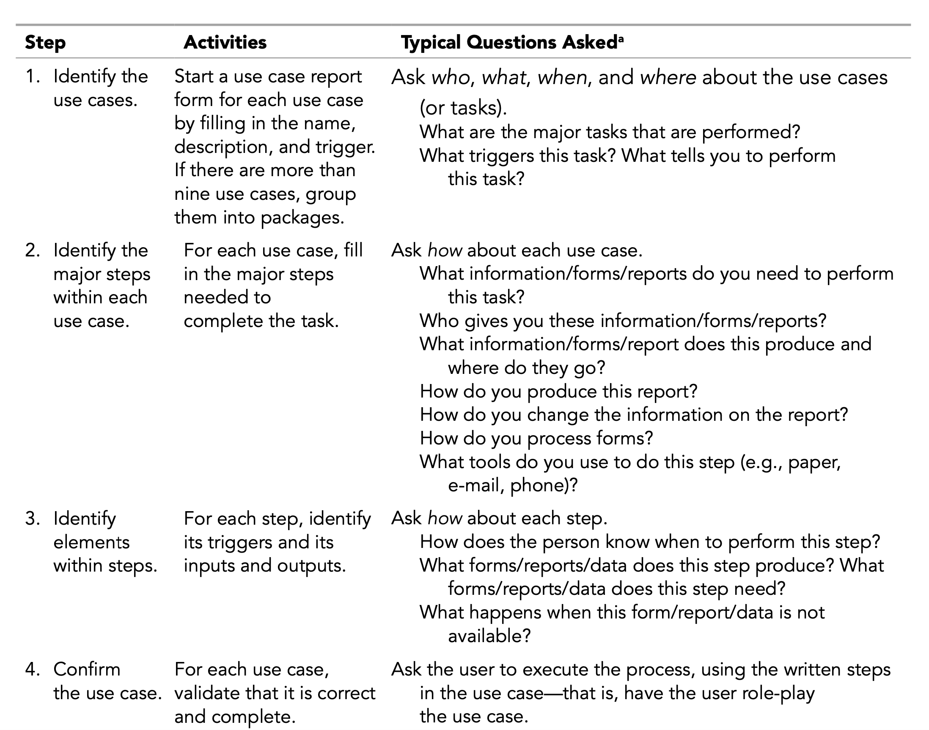
Use Case Analysis – Identifying Major Use Case

Slide 47
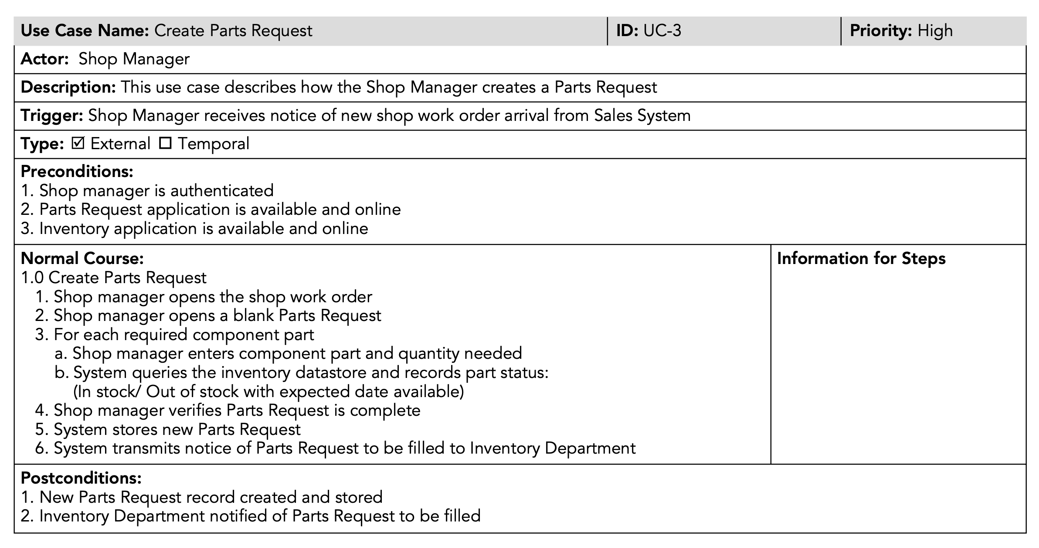
Use Case Analysis – Use Case in Document

Slide 48
Hmmmm..
That’s end of Unit II
Thank you

